Slide 1
SPRING 2021 TOWN HALL

Slide 2
AGENDA
Enrollment
Financial Position
Carlos Alvarez Naming
Building Updates
Fall Work Modality Planning

Slide 3
Spring Enrollment
College continues to grow enrollment
Positive impact for budget
Undergraduates
4%
5,962 students
Graduates
43%
1,345 students

Slide 4
Revenue Based on Activity
(enrollment, credit hours)
IRM Distribution for FY22
$801,493
https://www.utsa.edu/budget/irm/training-resources.html

Slide 5
Goals for IRM Distribution
FACULTY SUPPORT
Instructional Needs
Potential Salary Adjustments
STUDENT SUPPORT
COLLEGE INVESTMENTS
Staff Resources

Slide 6
Carlos Alvarez Gift
Research/TRIP Eligible

Slide 7
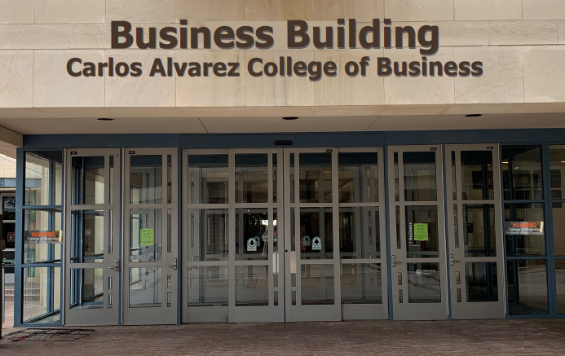
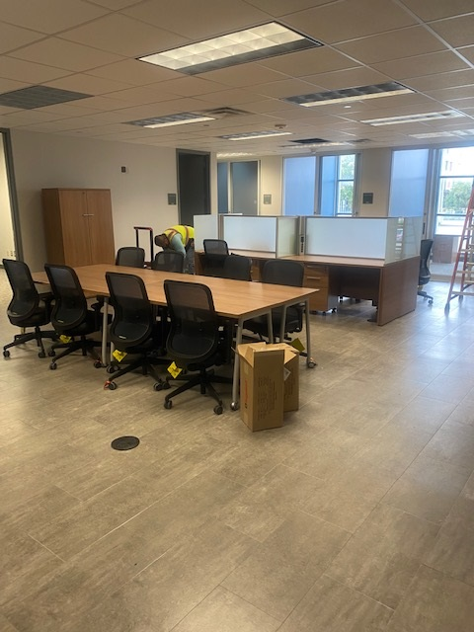
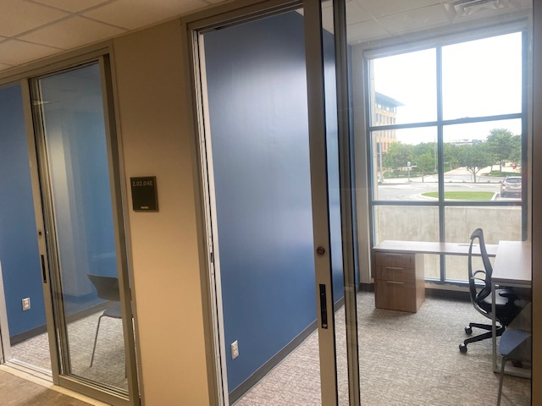

Slide 8
Work Modality
Department units submit business cases to Dean
Final communication no later than July 1

Slide 9
Questions?

